Slide 1

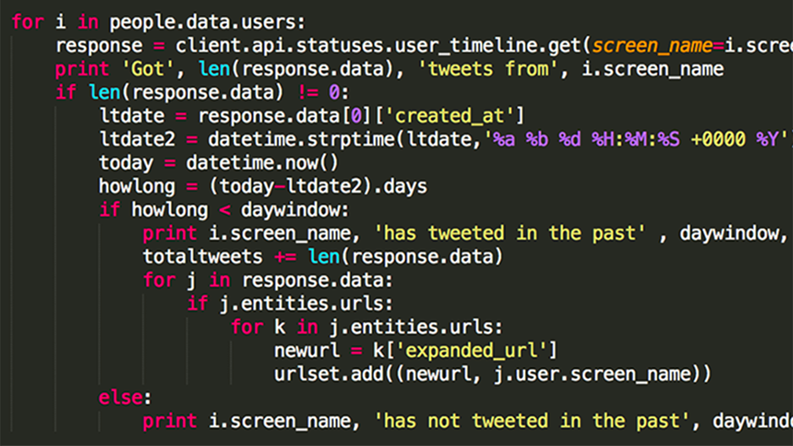

Tutorial on Assignment 3

Slide 2
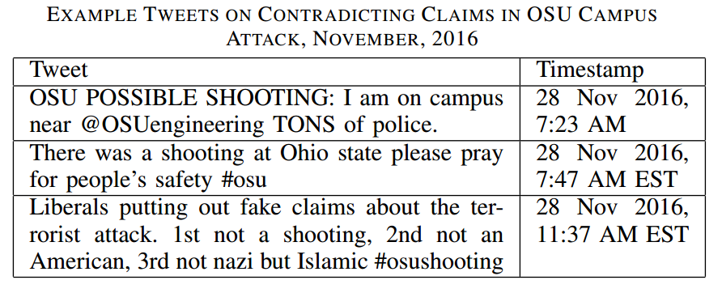
Assignment 3
Objectives
Learn how to use the maximum likelihood estimation (MLE) approach to solve the truth discovery problem
Build a MLE based tweet credibility analysis tool using Expectation Maximization to analyze the credibility of reported tweets.
Who is telling
the truth?

Slide 3


Assignment 3
What if source C is much more reliable than A, B? Or what if A, B lie a lot?
Sources
Claims
1
A
B
C
1
0
0
0
1

Slide 4
Tracking User Reliability
a – if claim is true, how likely a source reports true
b – if claim is false, how likely a source reports true
Z – whether a claim is true or not

Slide 5
EM Intuition
Sources
Claims
a =?
b =?
1
A
B
C
Z =?
1
0
a =?
b =?
0
0
a =?
b =?
Z =?
1

Slide 6
Input
Input – a Sensing Matrix SC, i.e., S_{i}C_{j}=1 indicates that S_{i} reports C_{j} to be true, and S_{i}C_{j}=0 otherwise.
Output – for each claim, decide it is “true” or “false”
 | Claim 1 | Claim 2 | … | Claim N
Source 1 | S1C1 = 1 | S1C2 = 0 | … | S1CN = 1
Source 2 | S2C1 = 1 | S2C2 = 0 | … | S2CN = 1
… | … | … | … | …
Source M | SMC1 = 0 | SMC2 = 1 | … | SMCN = 0

Slide 7
I’ve spent hours reading the paper but still have no clue about the math?

Slide 8
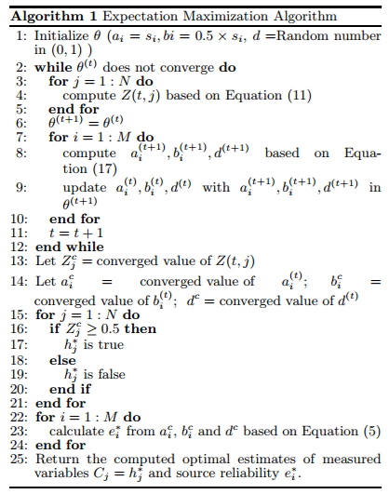
Assignment 3
All you need to know is in the algorithm!
Once you take the time to understand the variables, it will all make sense.
Just take it piece by piece.

Slide 9
Step 1 - Initialization
First step is to initialize θ (i.e., a, b, d)
These values will change in the EM steps.

Slide 10

Step 2 – Convergence Signal
EM is an iterative algorithm that will repeats until convergence
Counter (recommended)
Check change of θ
e.g., Parameters a,b,d does not change by ε
EM Steps

Slide 11

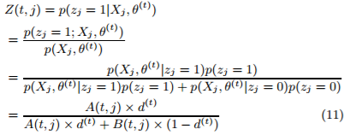
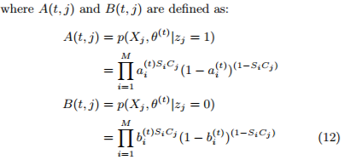

Step 3- E Step
Well what’s Z(t,j)? Look at Equation 11!
Now what are A(t,j) and B(t,j)? Look at Equation 12!
We know what all of these are! So we can figure out everything.
Remember:

Slide 12
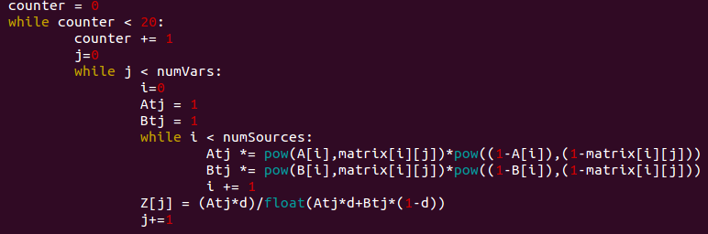
Step 3- E Step
So calculating A(t,j), B(t,j) and Z(t,j) looks something like:
Where matrix[i][j] represents SiCj

Slide 13
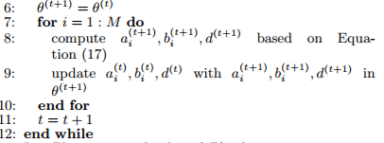
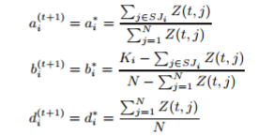
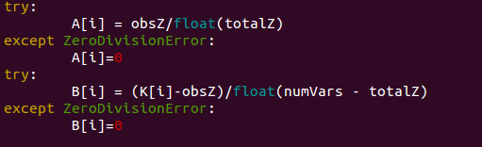
Step 4- M Step
This time we need to look at Equation 17.
Again, this all looks simple and we can implement it easily.
Not everything is shown here but the idea is pretty clear

Slide 14
So What Does EM Actually Do?
In the truth discovery problem, we have parameters a,b,d, and latent variable Z
E-step: given (estimated) a,b,d, derive Z
M-step: given derived Z, estimate a,b,d
Repeated until convergence
a – if claim is true, how likely a source reports true
b – if claim is false, how likely a source reports true
d – how likely a claim is true
Z – a binary variable denoting a claim is true or not

Slide 15
3 More Tips
Make sure you cast to a variable to a float to avoid integer division errors.
Don't expect the estimator to do perfect classification on Sensing Matrix file. There will be a few misclassifications. It should only do perfect classification on the three Test files.
Make sure you initialize ai to si, bi to 0.5 * si, and d to a random value between 0 and 1.

Slide 16
Assignment 3
Remember, everything you need is in the Assignment 3 document and the IPSN12 Research Paper!
Don’t stress out. Take it one section at a time.
http://www3.nd.edu/~dwang5/courses/spring20/assignments/A3/Assignment3_SocialSensing.html

